Slide 1
v
Częstochowa in
a poem by Gabrysia, Erasmus student

Slide 2
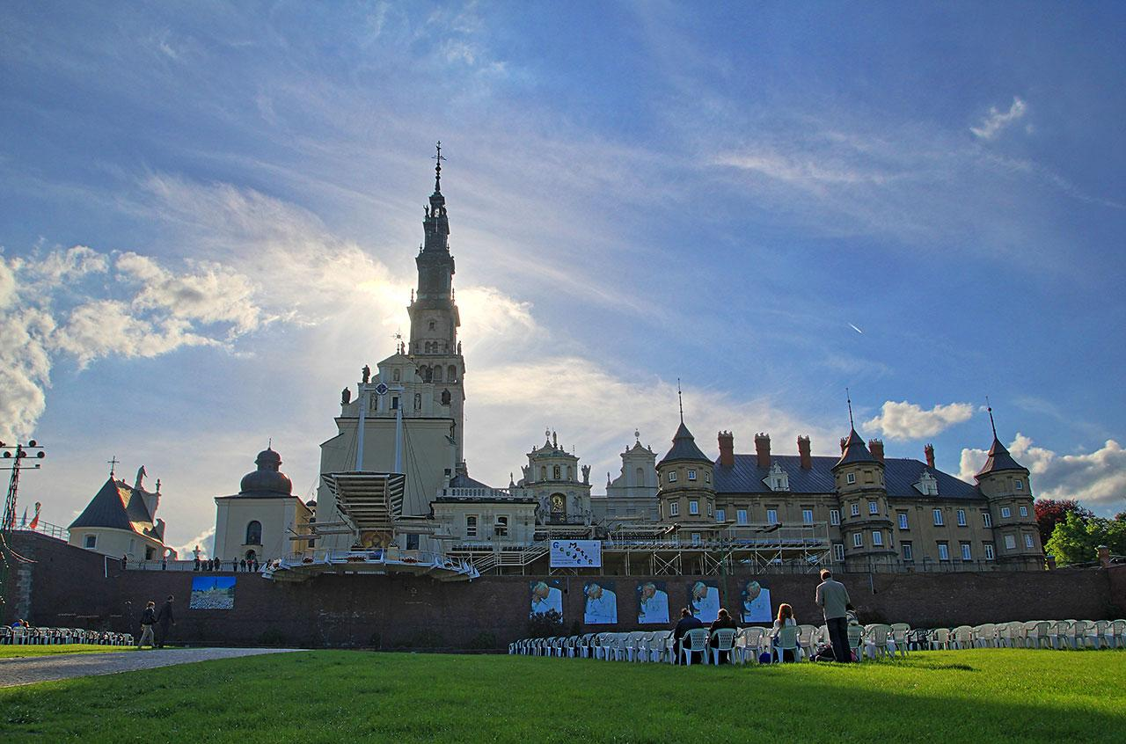
Not that far
far away
a city
has built itself
around a sharp
white tower
that shines
like a star
in the morning
and at
nightfall
Like a mountain
it towers above

Slide 3
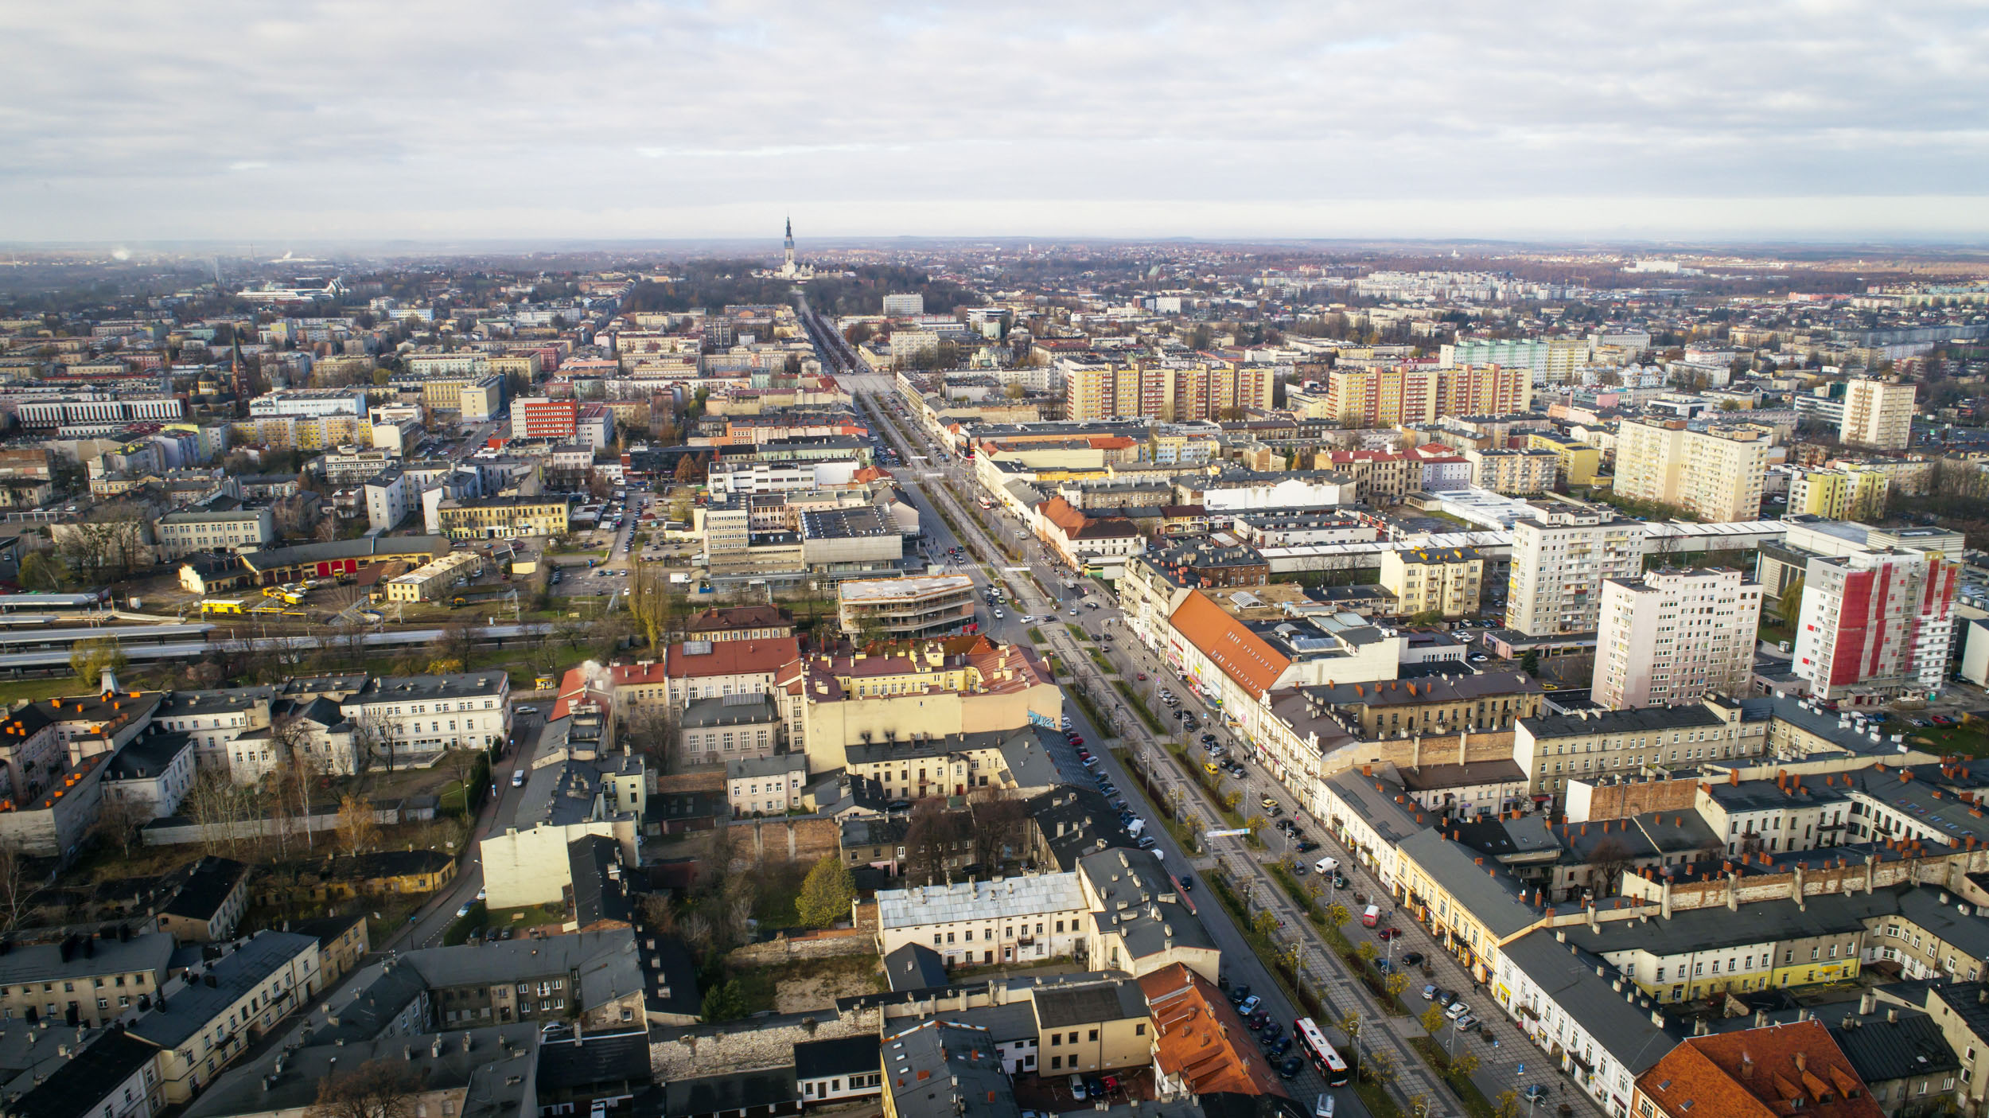
the city is mostly calm
and a long valley
like a green vein
goes straight through it
like it's leading to the heart

Slide 4
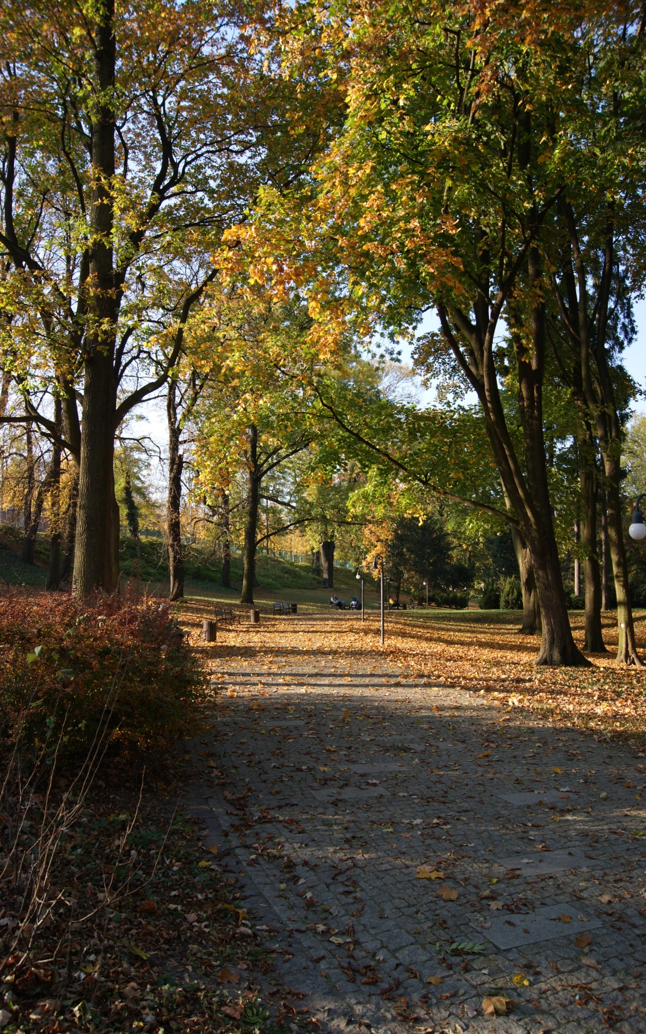
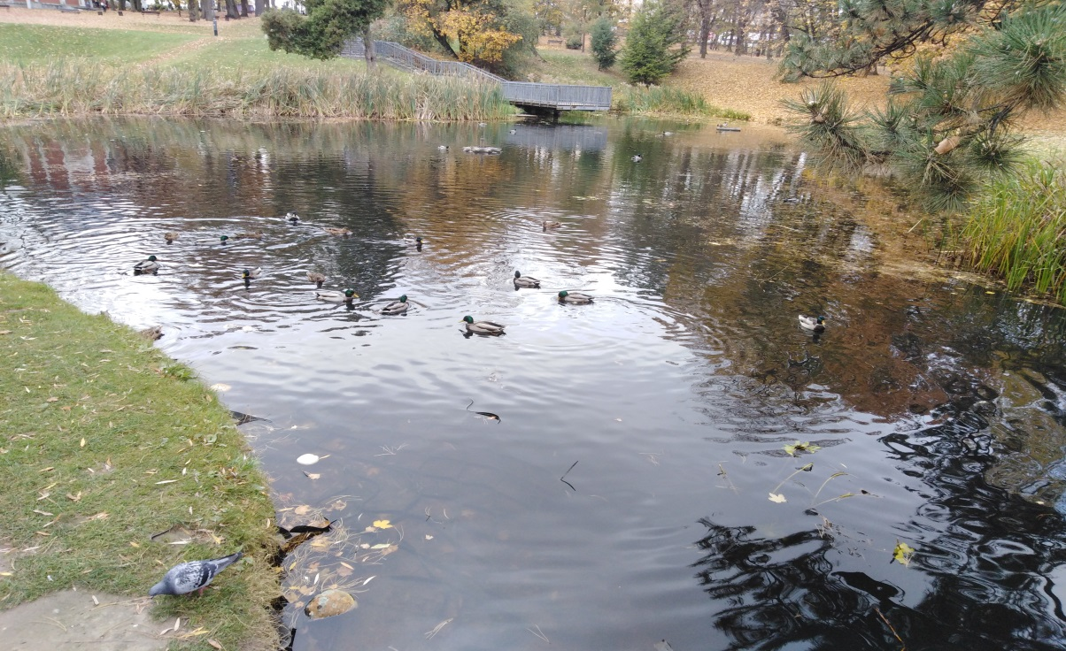
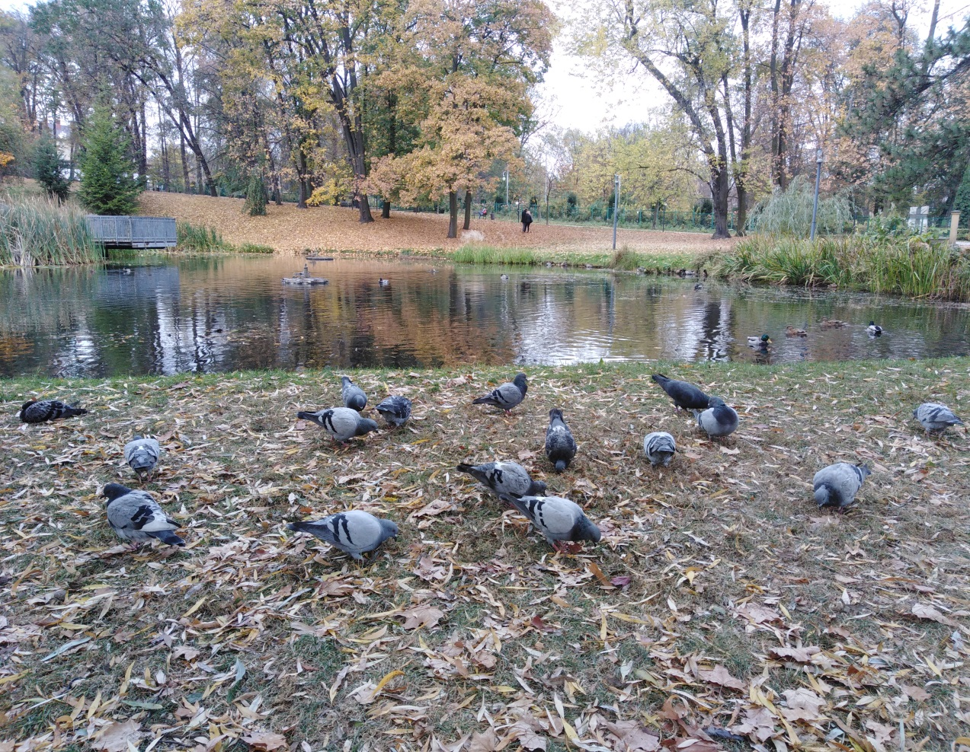
there beautiful people
see each other
there dogs meet other dogs
there you hear the tram slowly driving its way
there the bicycles ring
there the doves fly and coo
there flows life
and in the flow
some crazy fun things take place

Slide 5
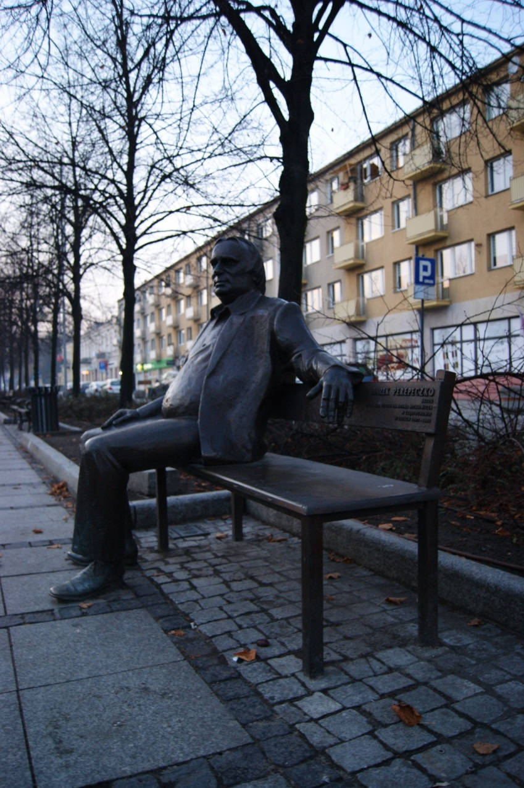
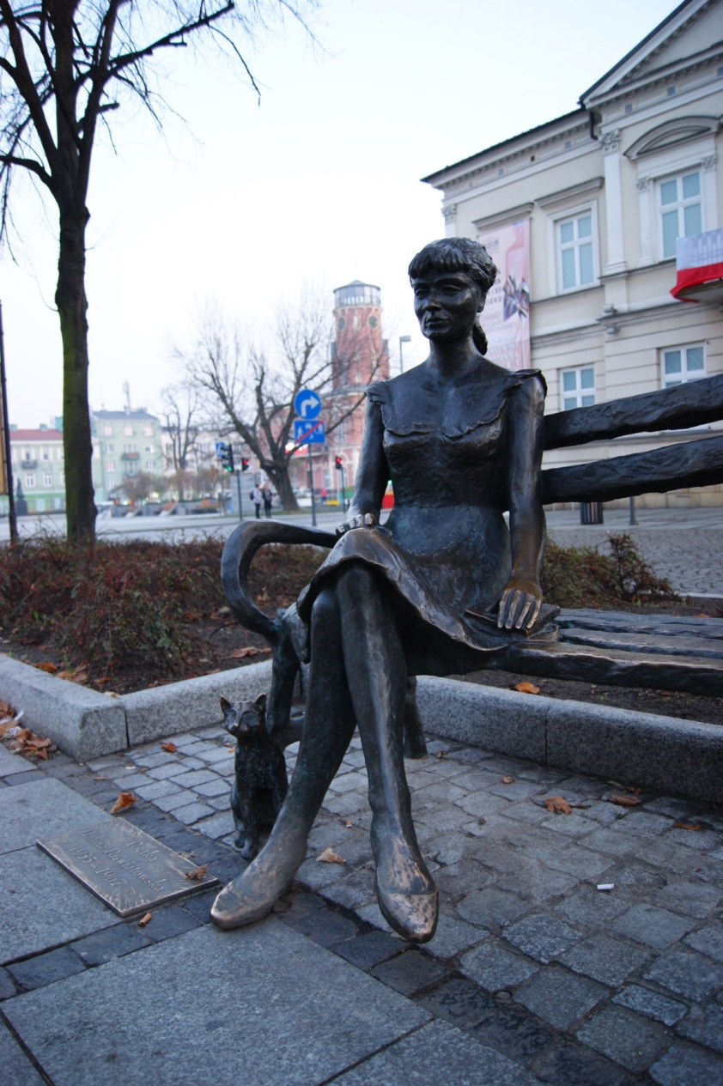
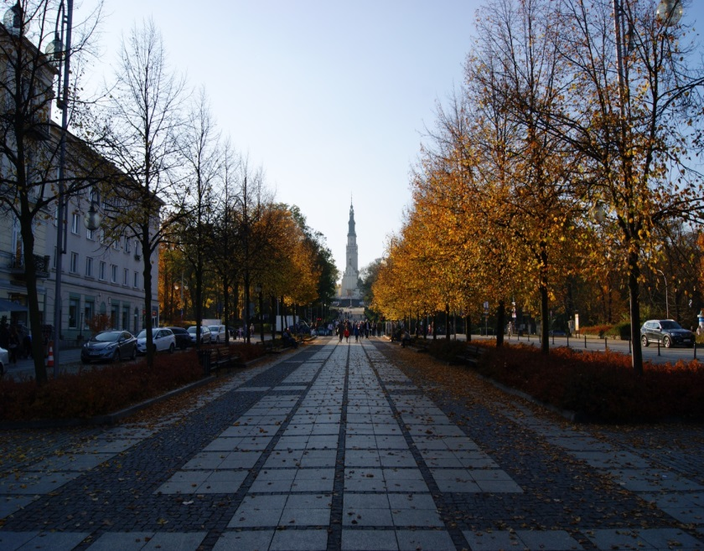
that city is Częstochowa
with its trams
and alleys
dogs
two benches
and the Monastery above

Slide 6
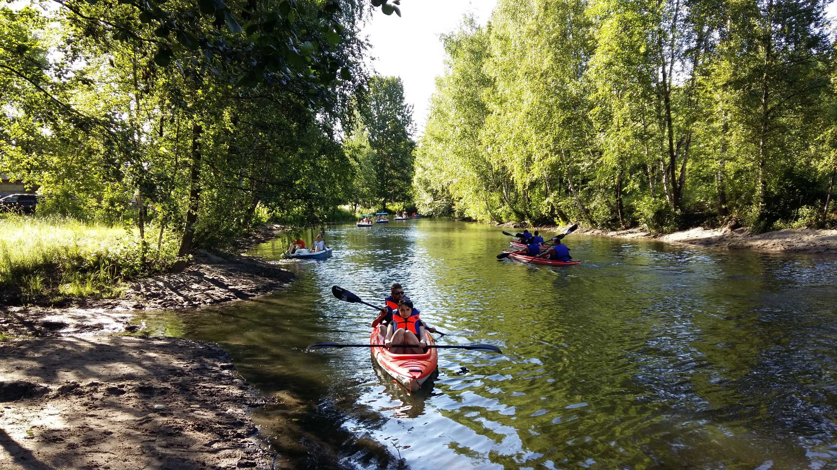
Peaceful, sweet
well not that idle maybe
but mine, ours
a place to live on the planet
that's what it is to me

Slide 7
just my Częstochowa, a city of angels and ghosts

