Slide 1
v

Slide 2
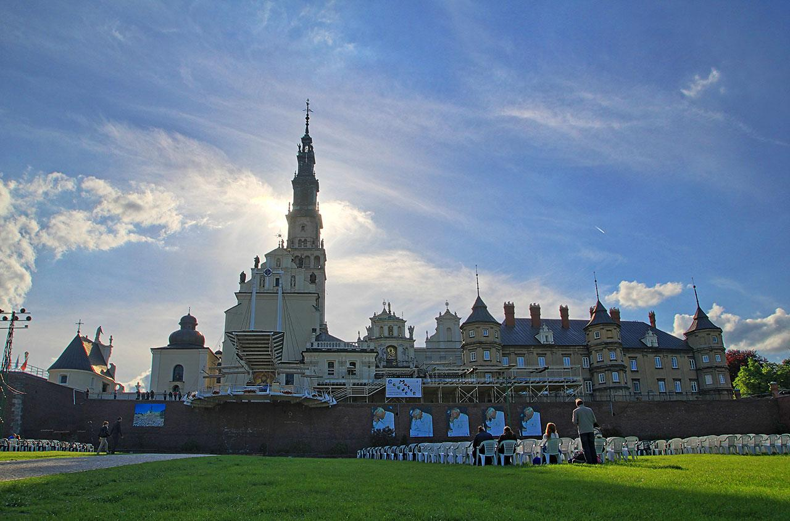

Slide 3
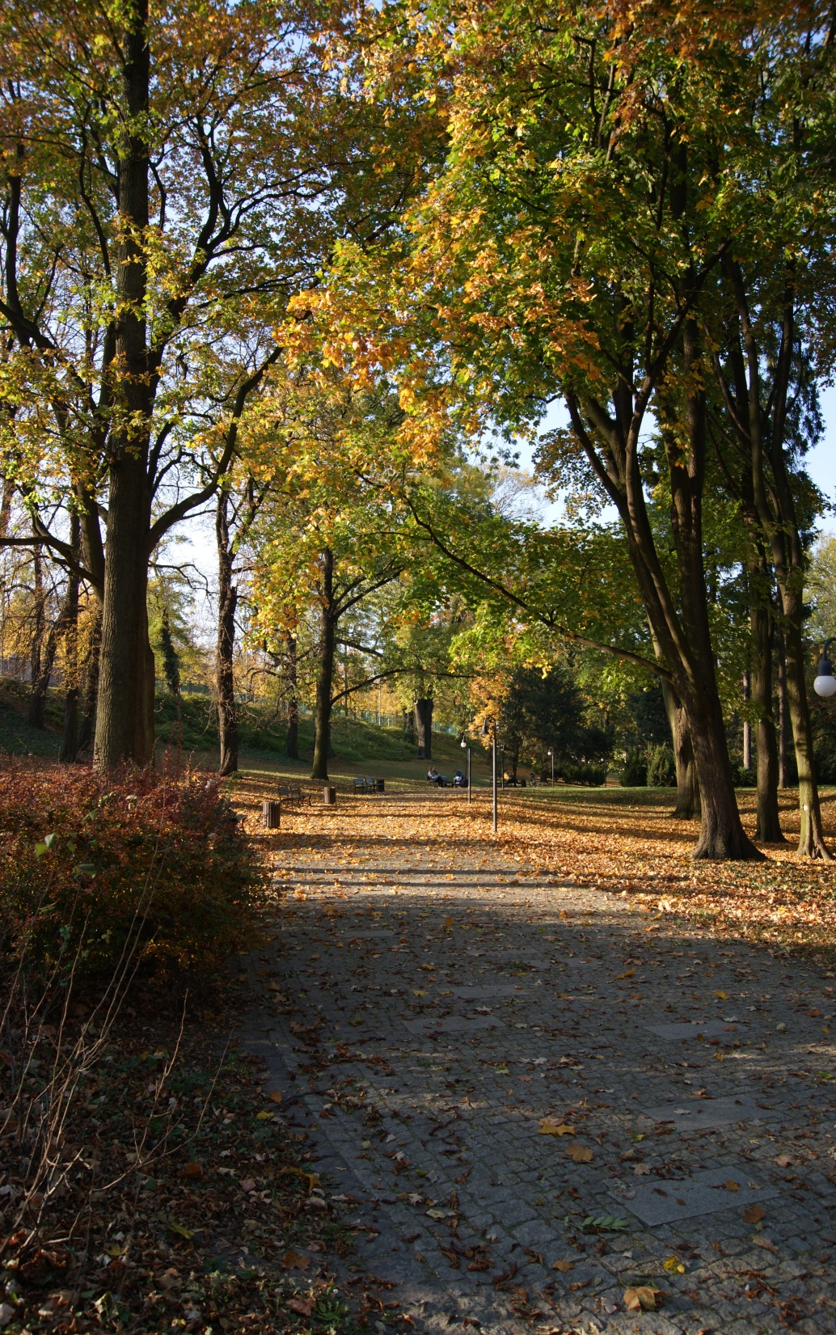
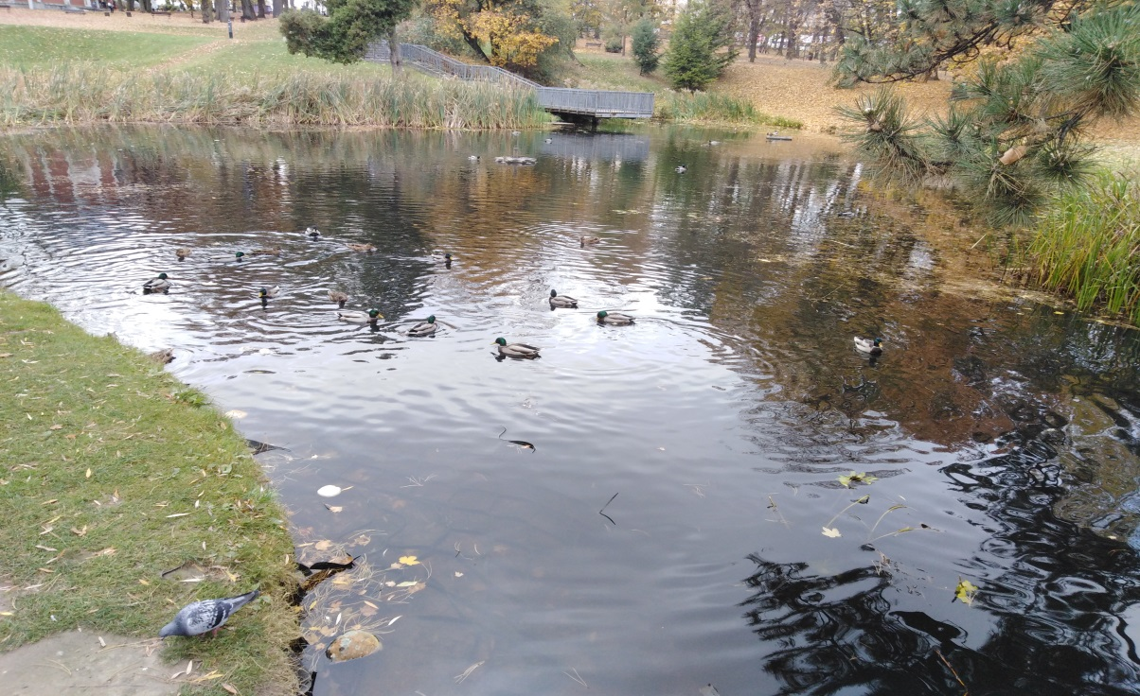
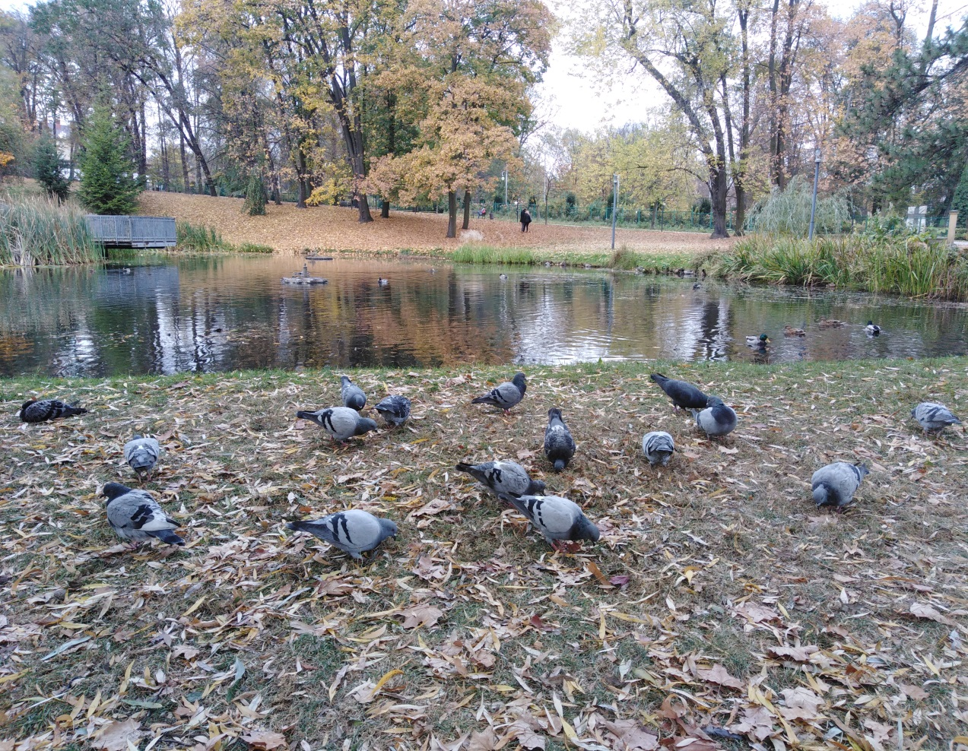

Slide 4
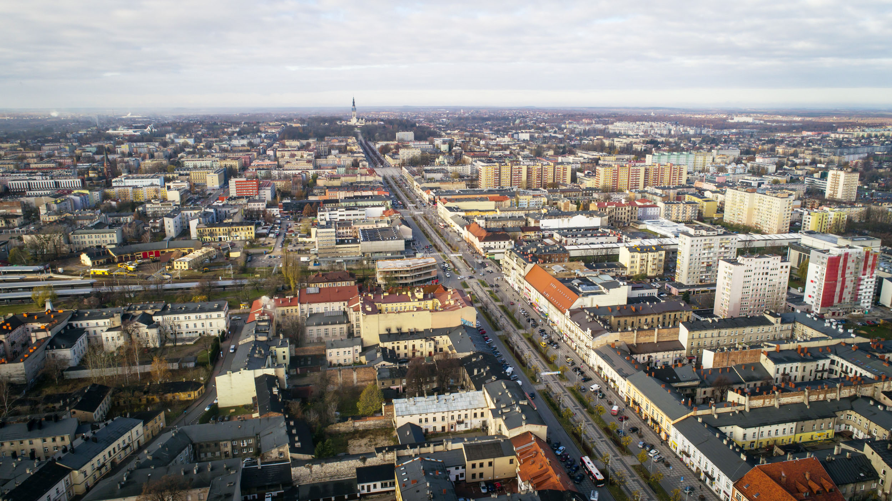

Slide 5
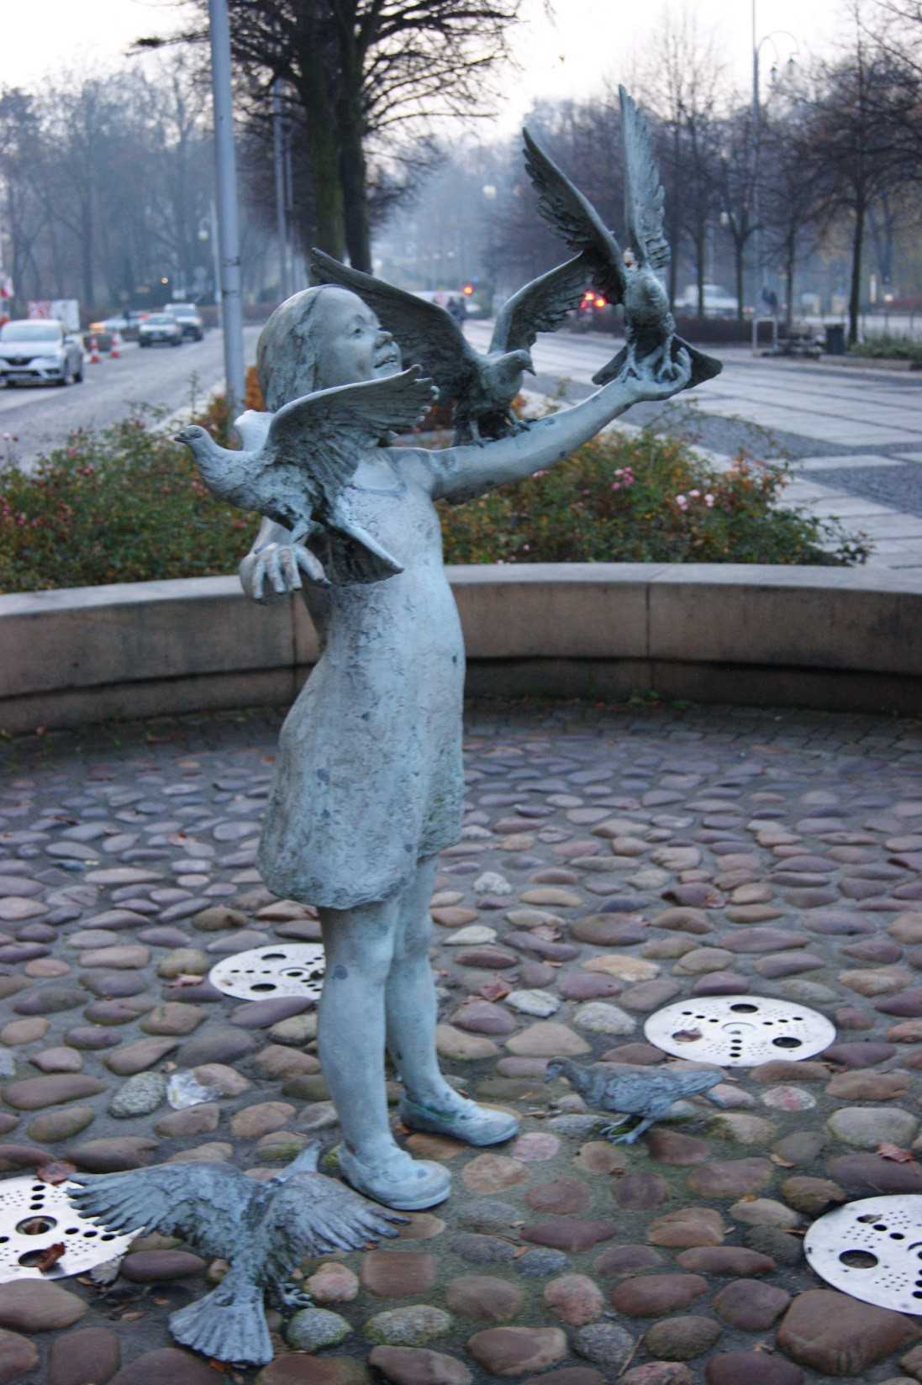
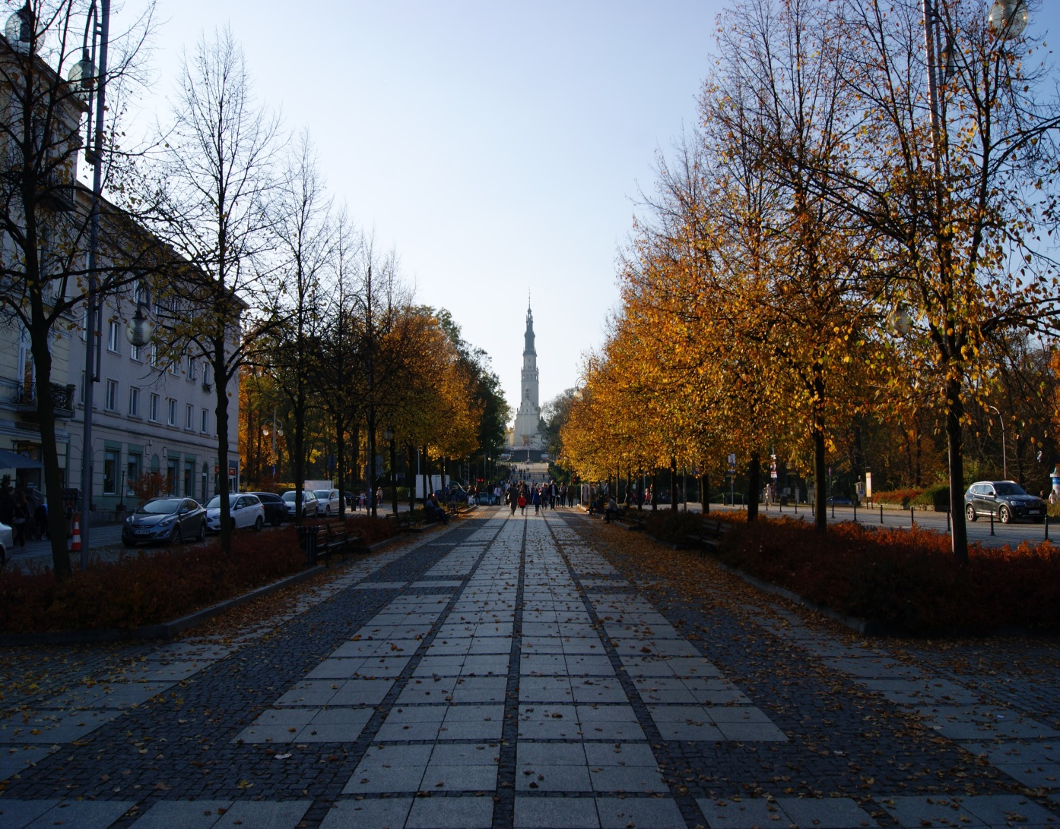

Slide 6
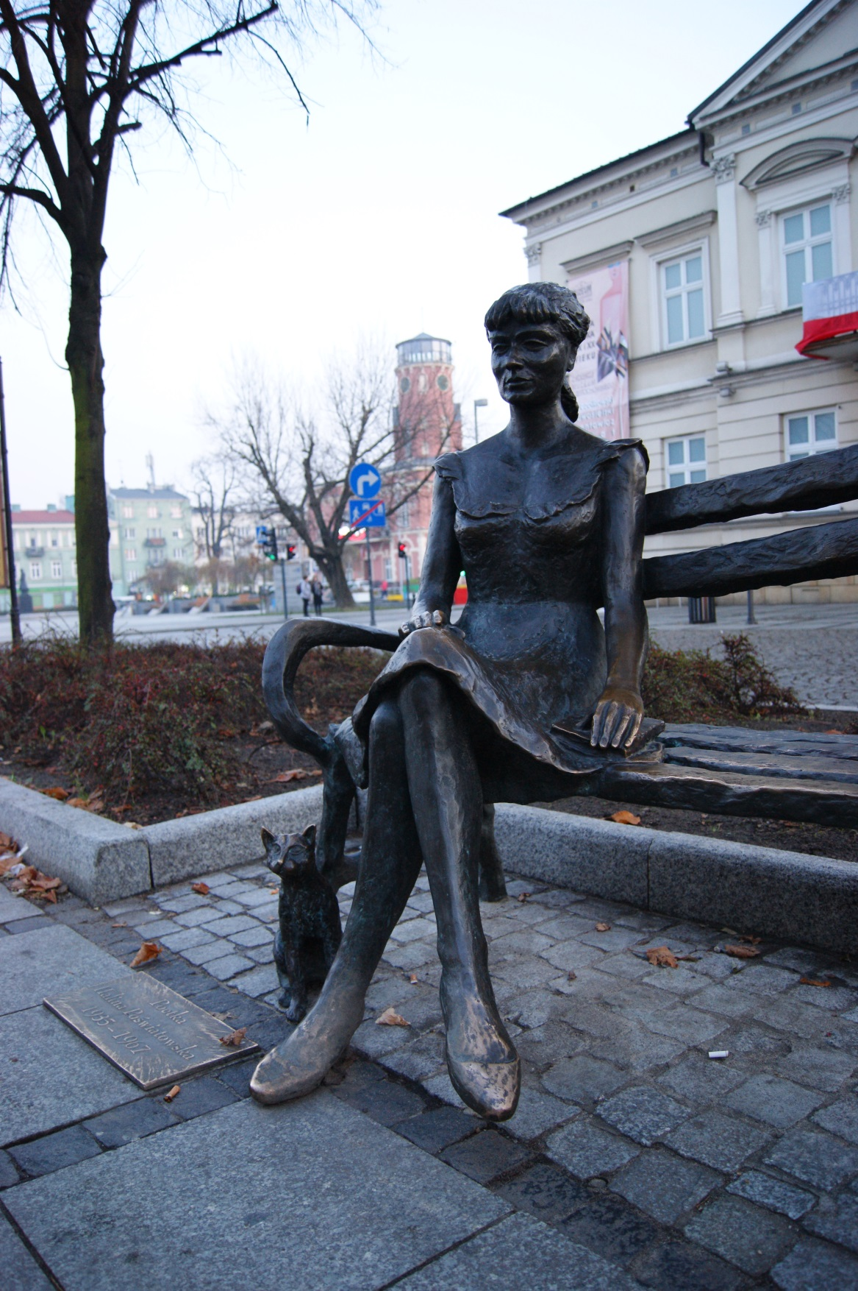

Slide 7
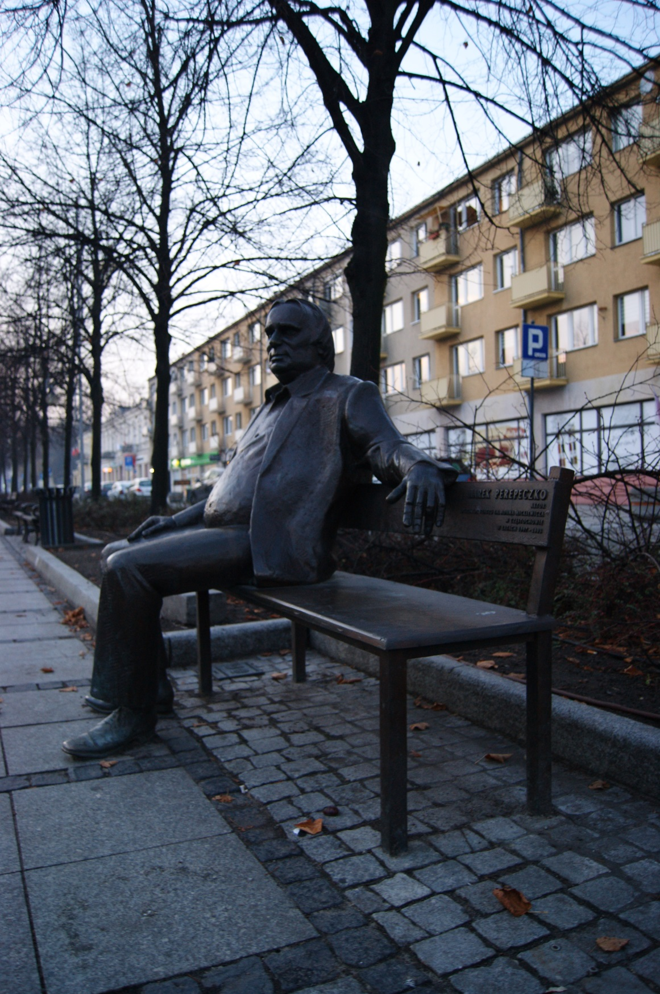

Slide 8
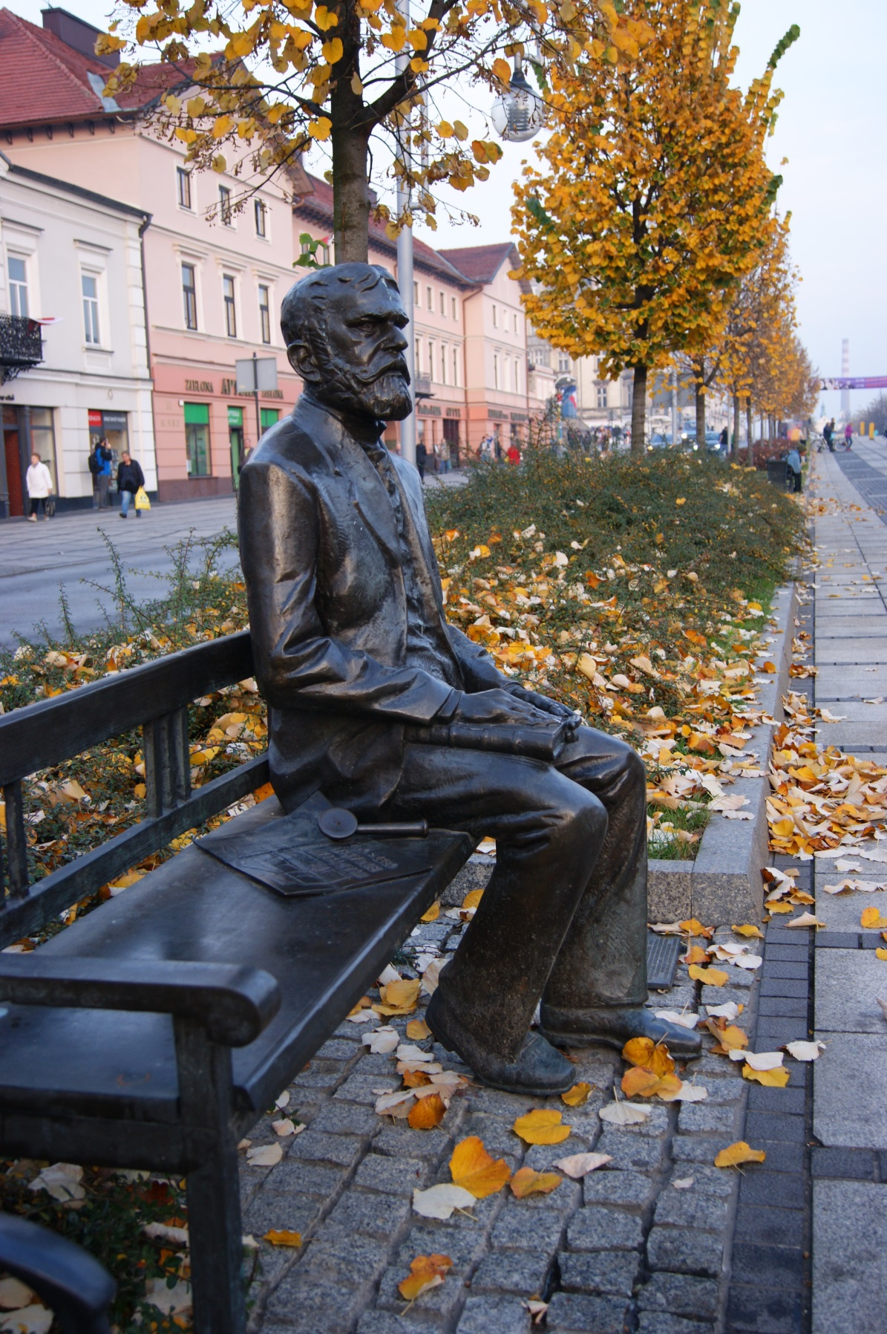

Slide 9
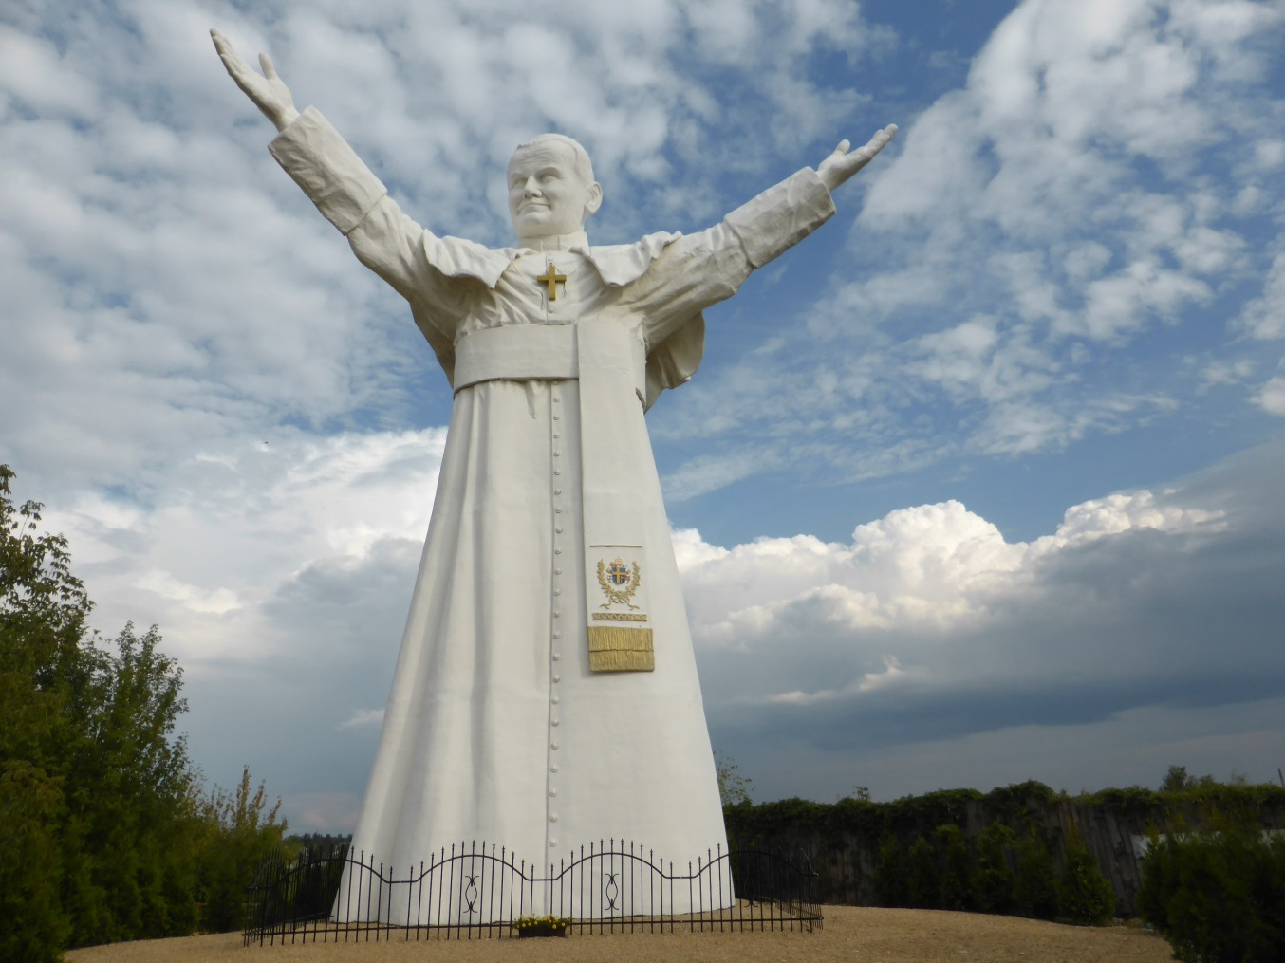
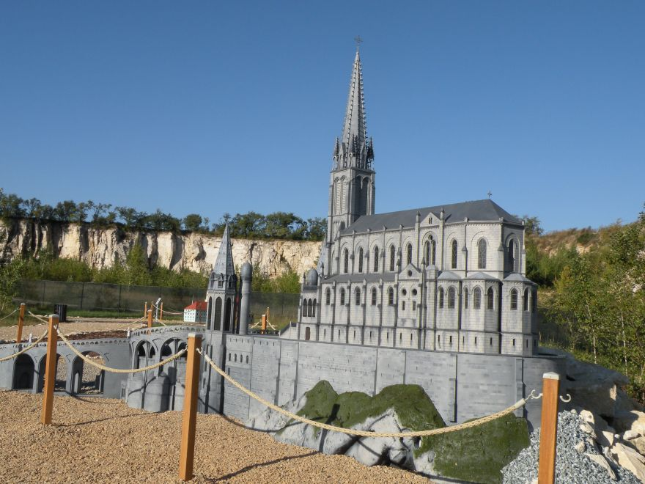
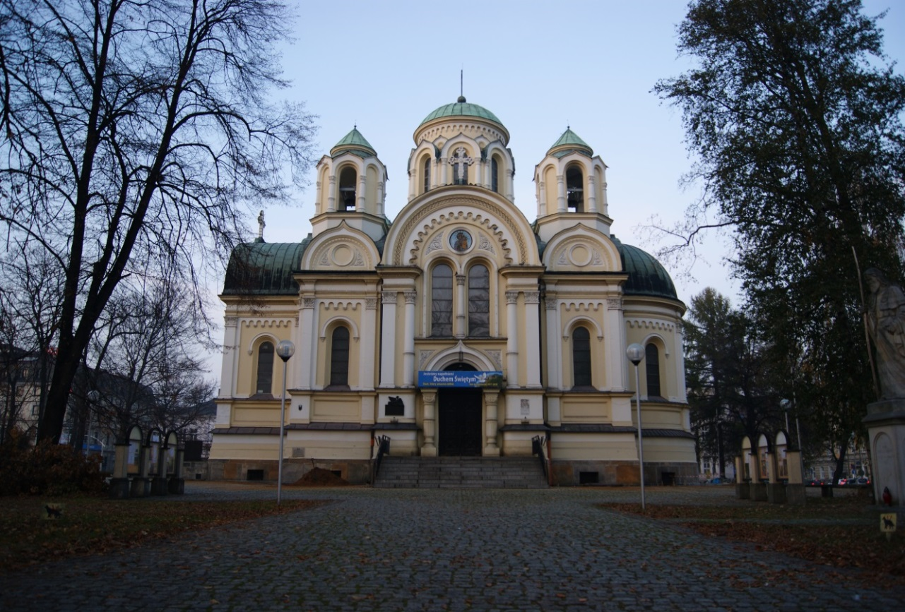

Slide 10
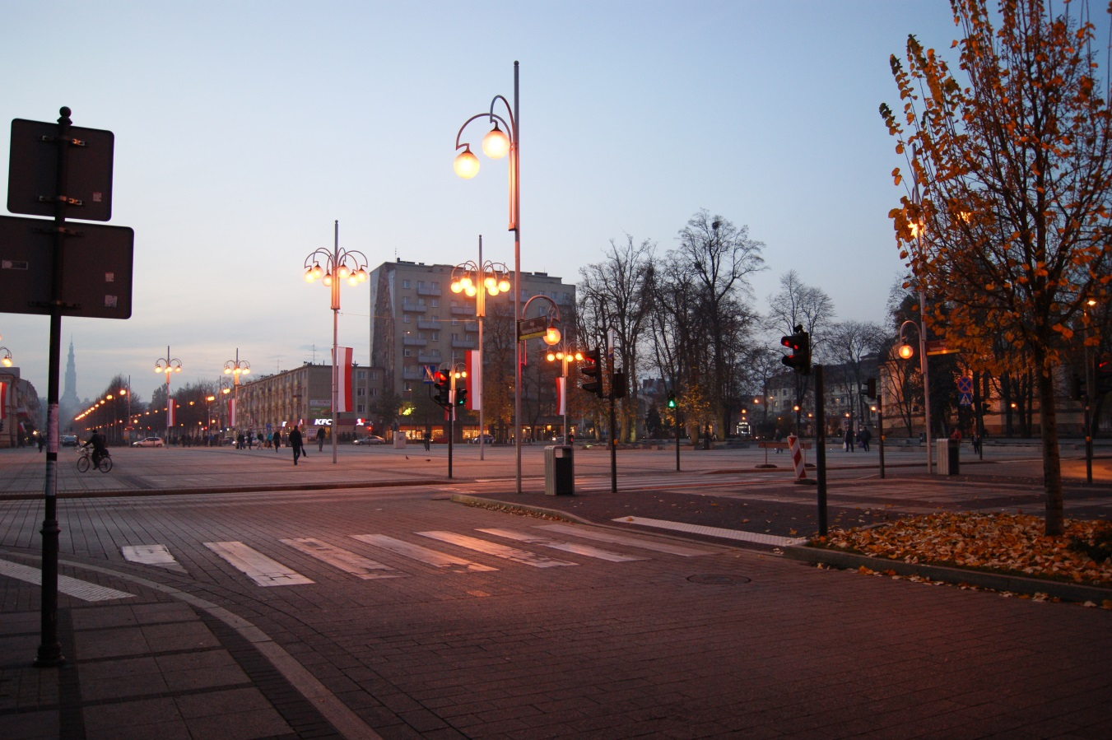
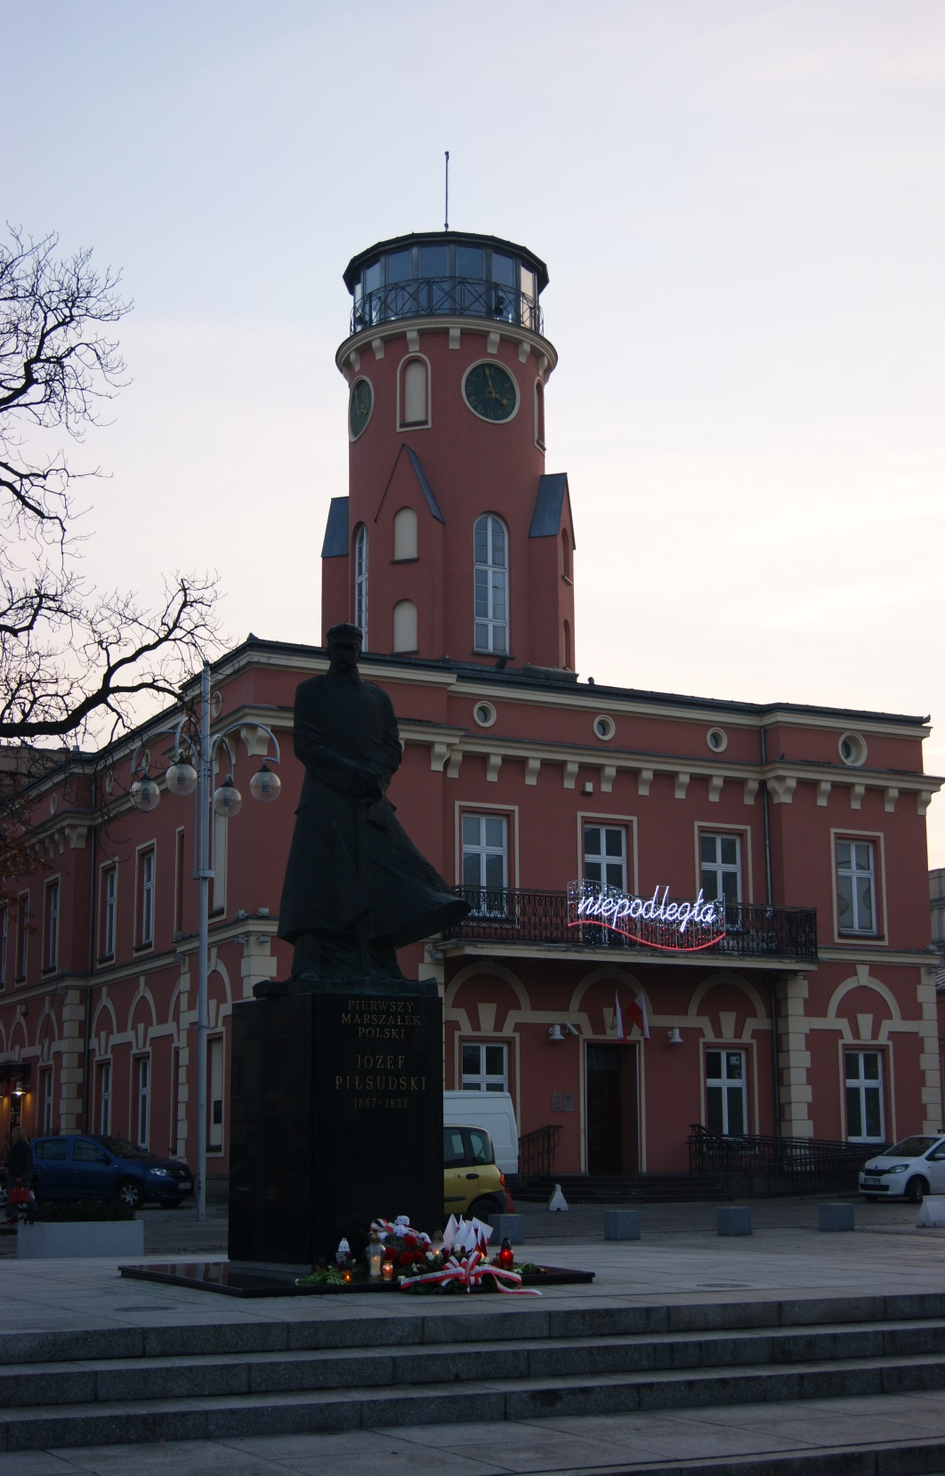
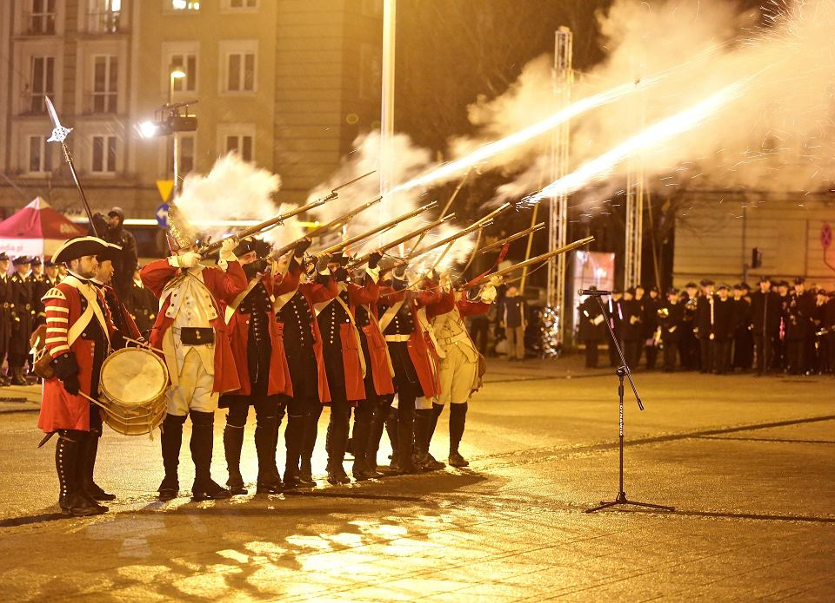

Slide 11
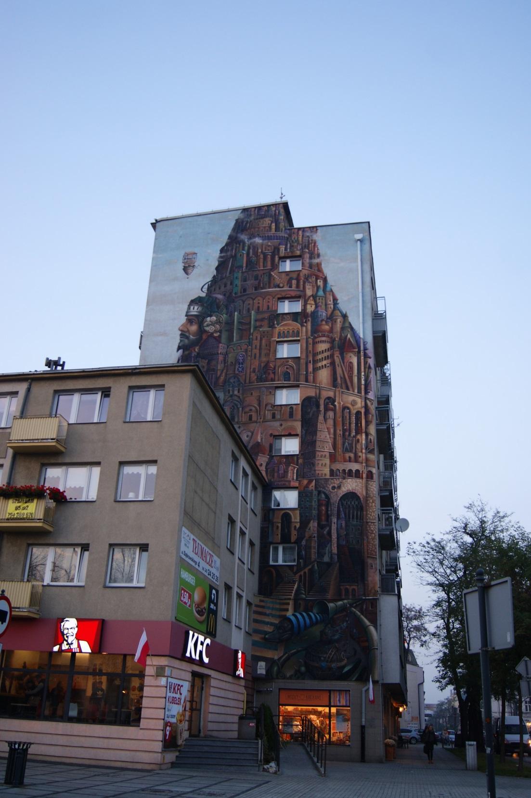
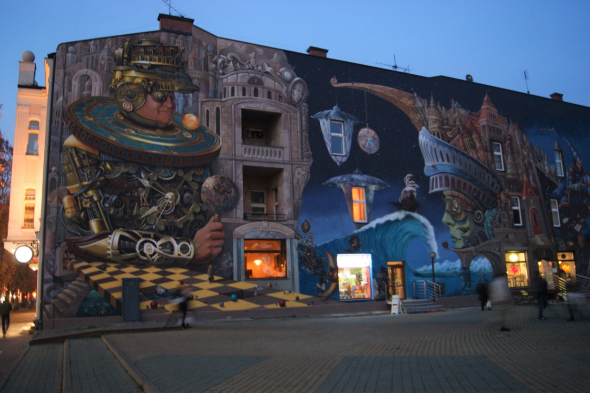

Slide 12
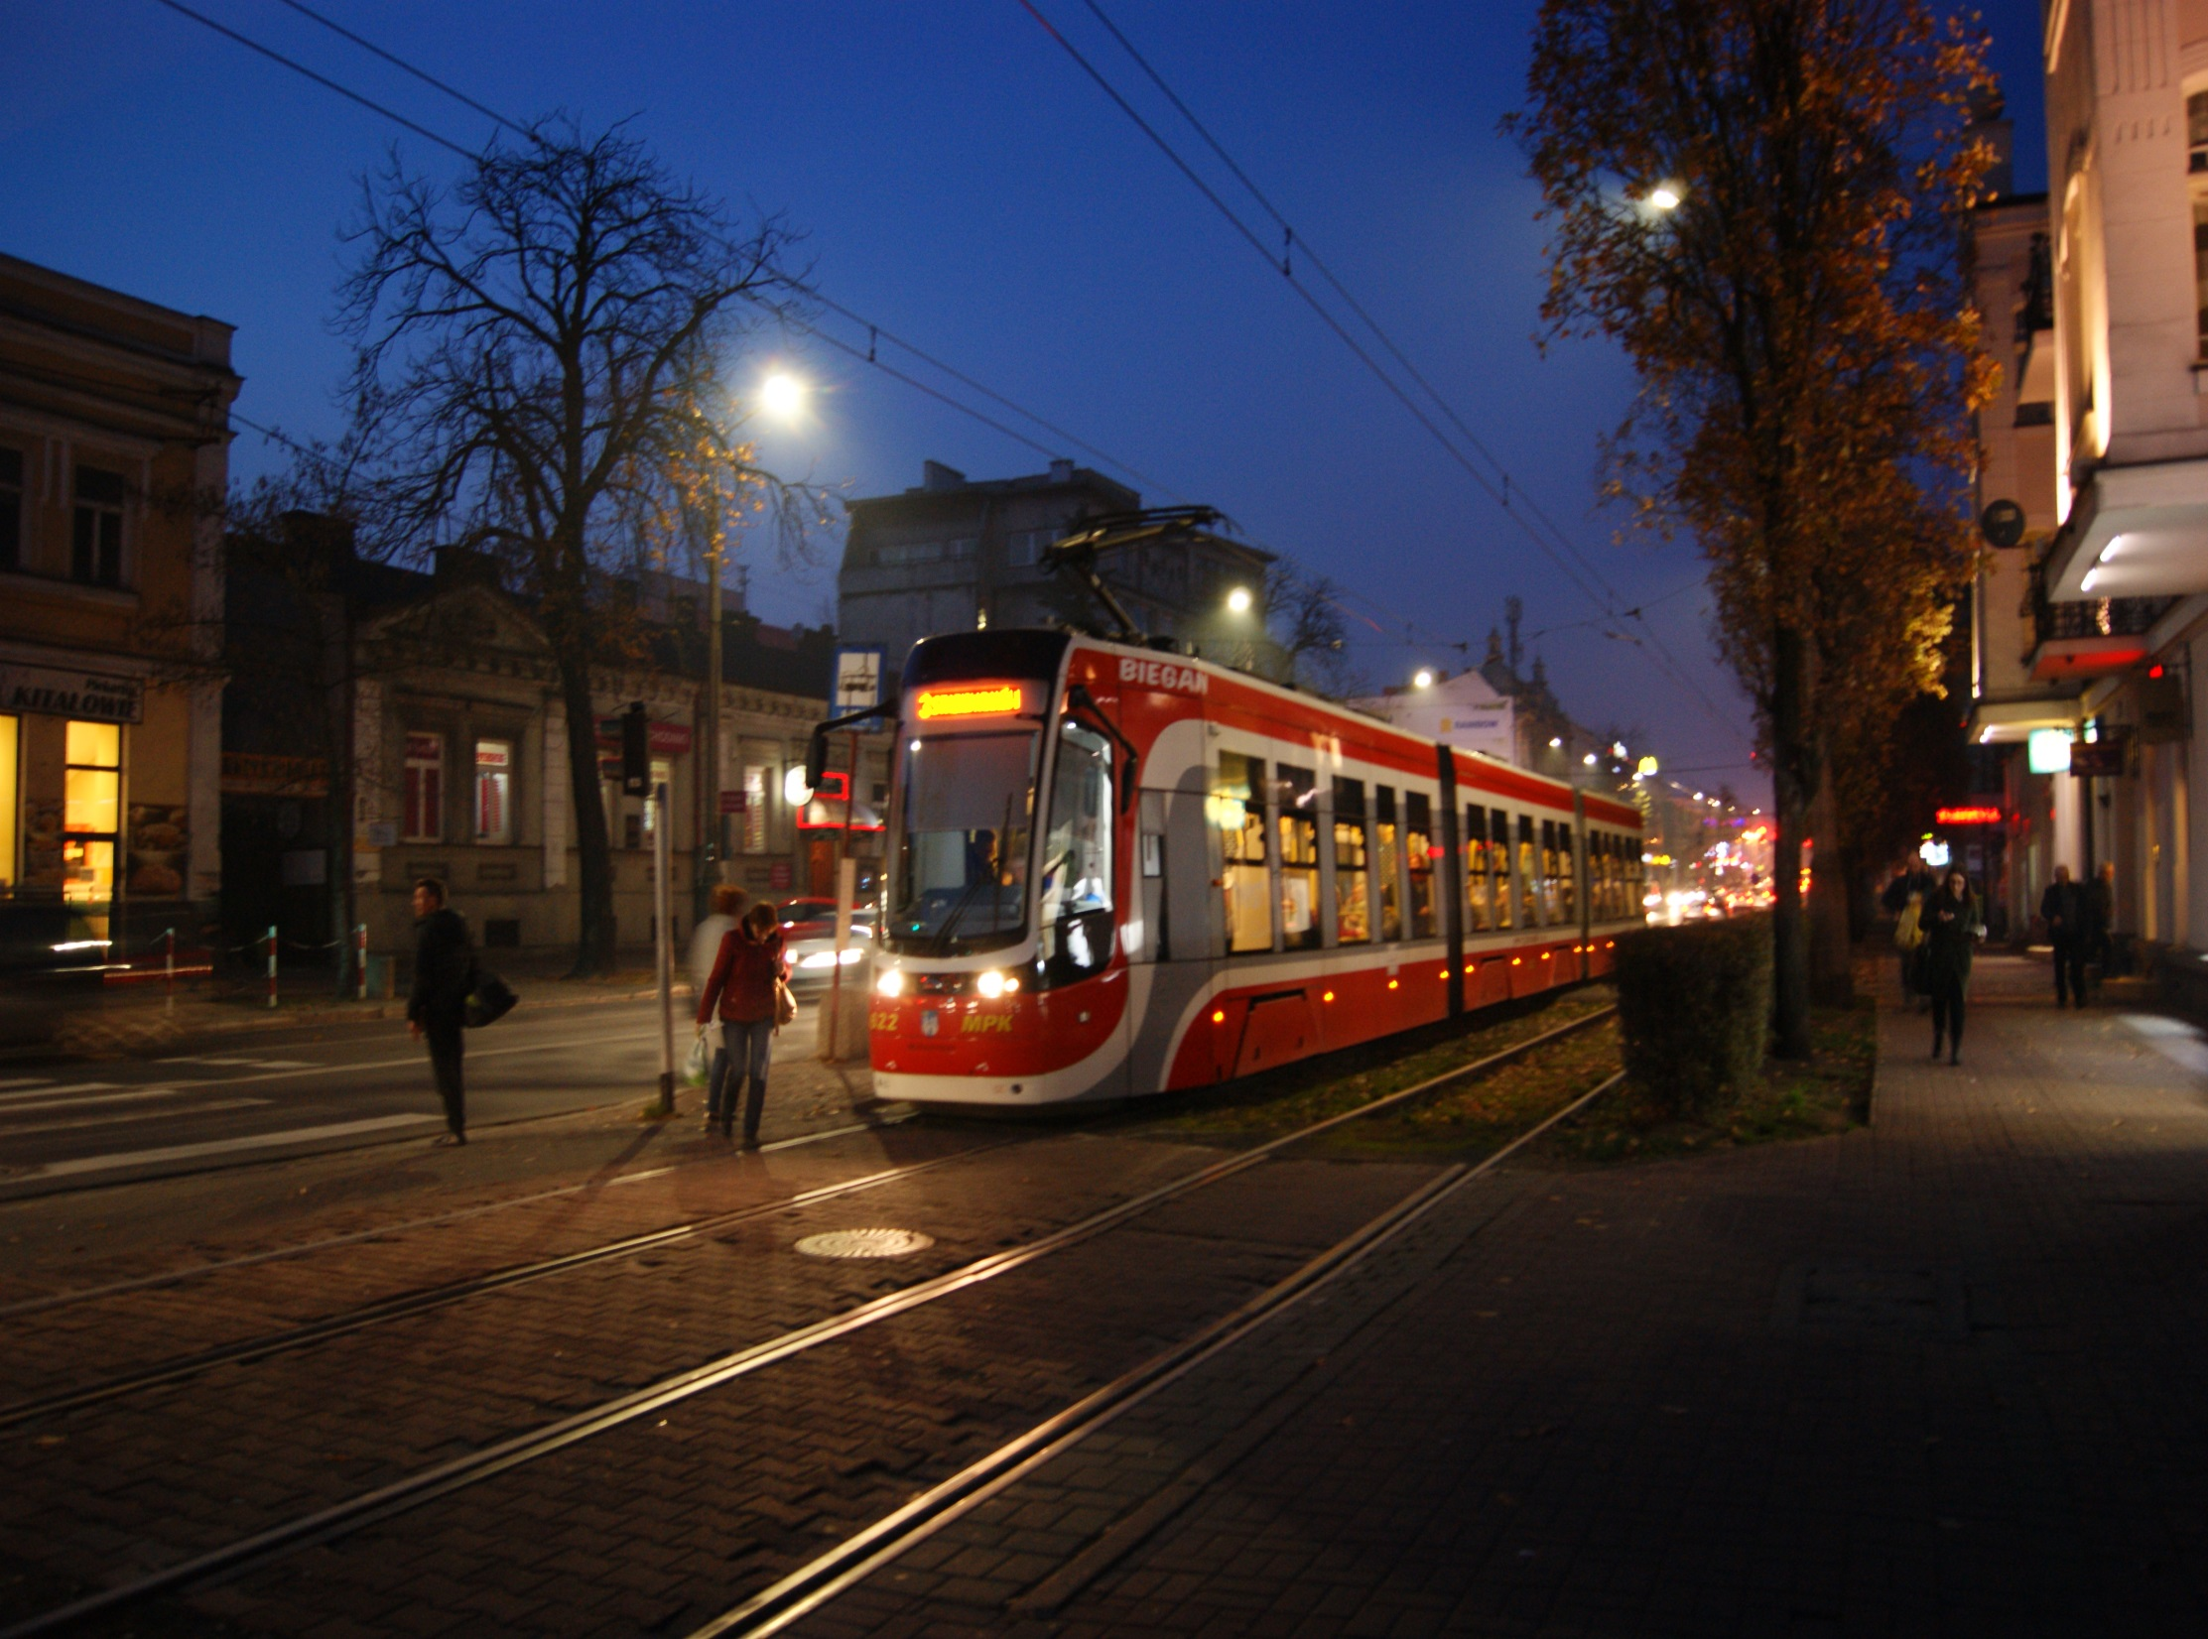

Slide 13
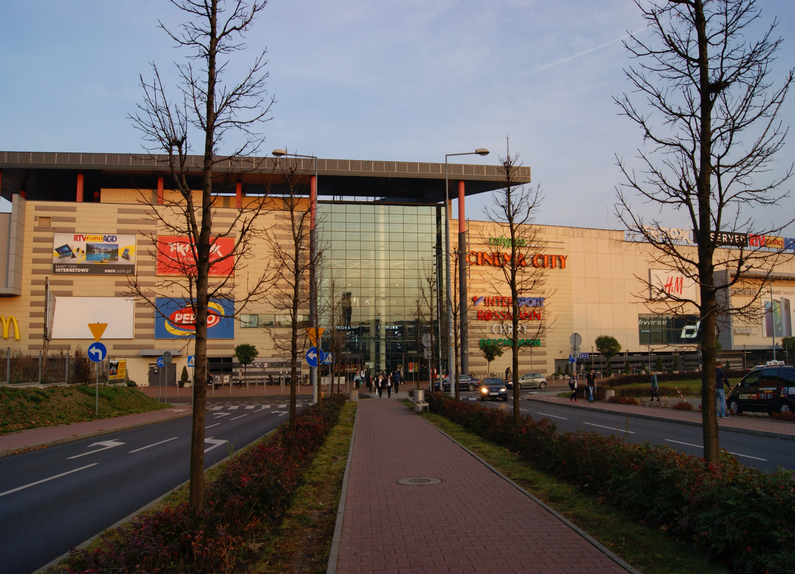

Slide 14
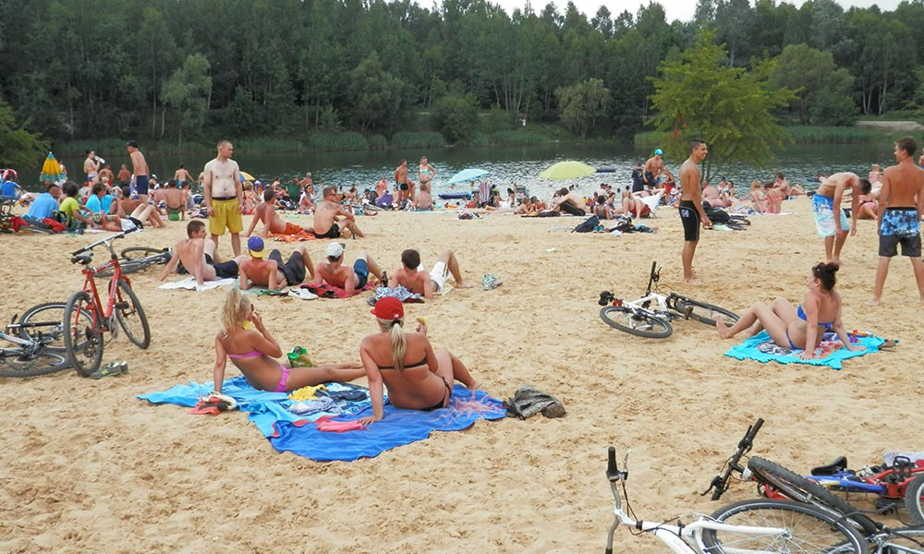

Slide 16
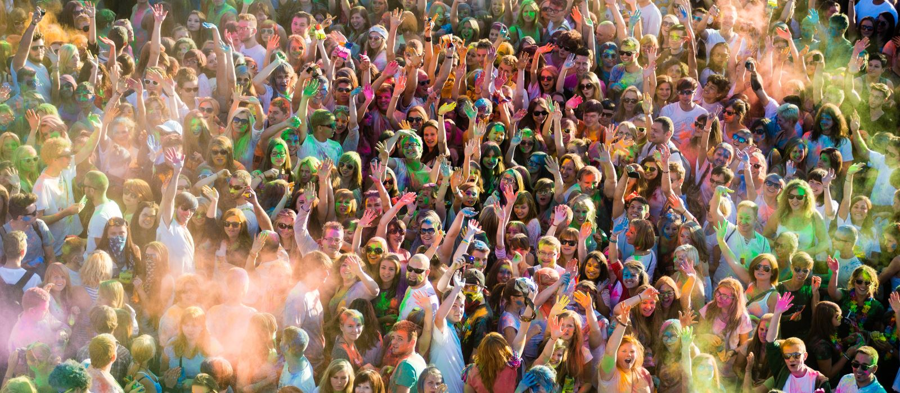
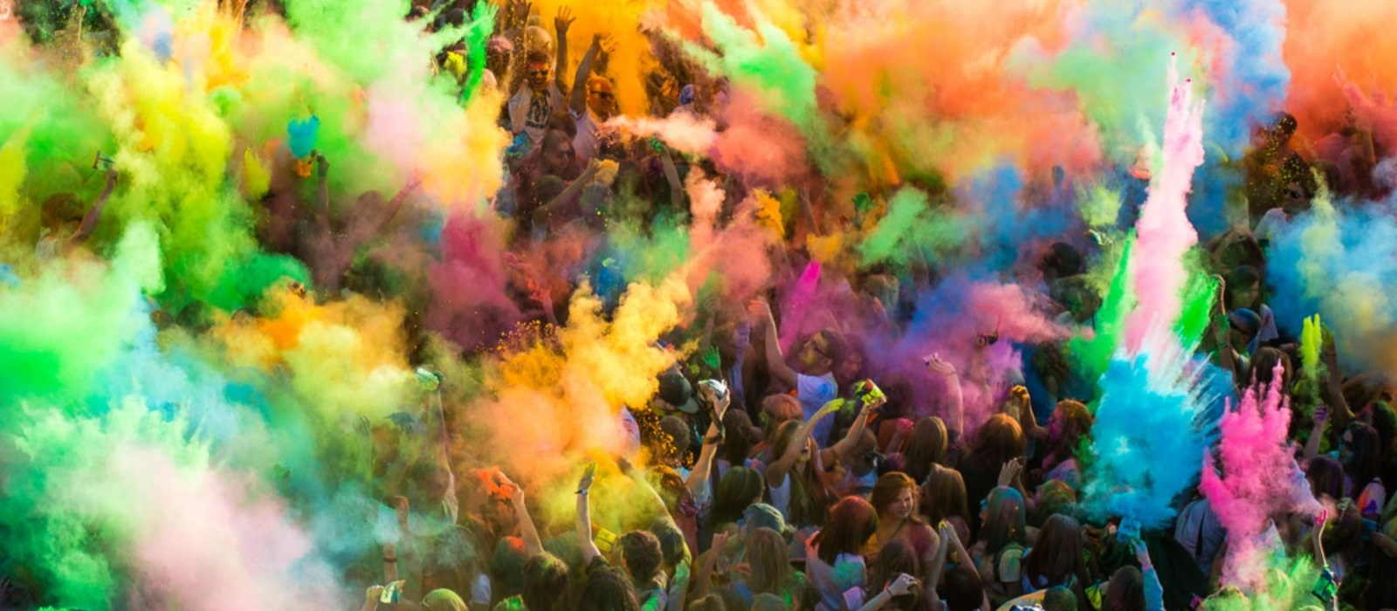

Slide 18
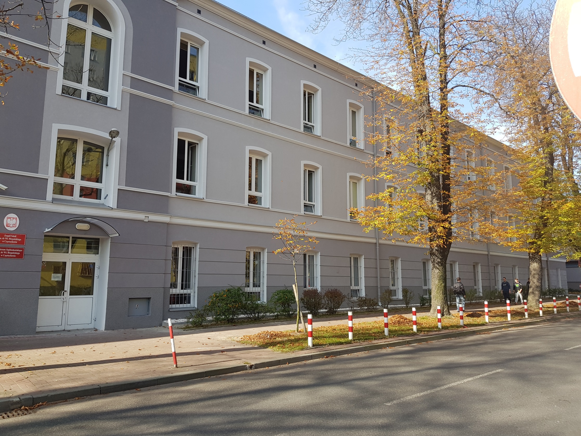

Slide 19
PECHA KUCHA
Pecha Kucha (Japanese: ぺちゃくちゃ, IPA: [petɕa kɯ̥tɕa], chit-chat) is a presentation style in which 20 slides are shown for 20 seconds each (6 minutes and 40 seconds in total). The format, which keeps presentations concise and fast-paced, powers multiple-speaker events called Pecha Kucha Nights (PKNs).
Pecha Kucha Night was devised in February 2003 by Astrid Klein and Mark Dytham of Tokyo's Klein-Dytham Architecture (KDa), as a way to attract people to SuperDeluxe, their experimental event space in Roppongi, and to allow young designers to meet, show their work, and exchange ideas.

Slide 20
Photographer:
Karolina –
Participant of Erasmus+
Author of the presentation:
Michał - student at
Biegański Secondary School
sources
Wikipedia.com
Google.com
Festiwalkolorow.pl
Czestokocham.pl
Jurazlotuptaka.pl

