Slide 1
The European Day of Languages
26th September, 2018

Slide 3
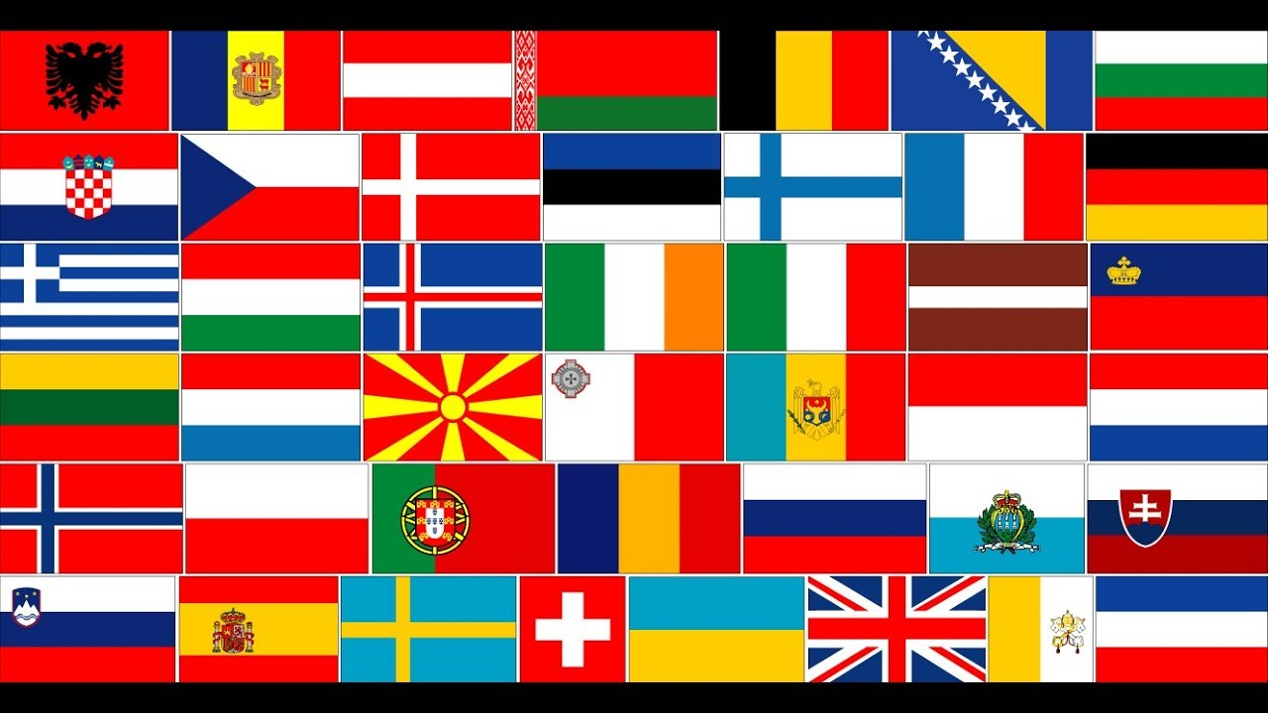
The European Day of Languages (EDL) is an annual celebration day, initiated by the Council of Europe. It has been celebrated every year, on 26th September, since the European Year of Languages in 2001.

Slide 4
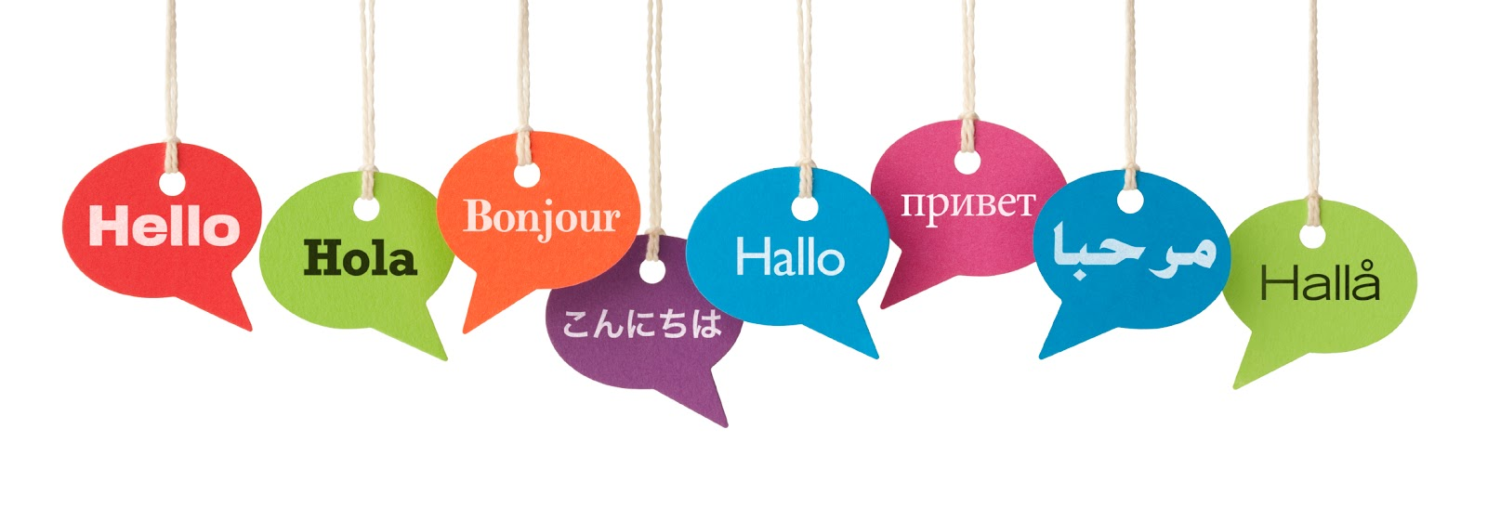
The main aim of EDL is to encourage the Europeans to learn foreign languages.

Slide 5
The project itself focuses on the organization of various events in European schools, universities and cultural institutions promoting language learning.

Slide 6
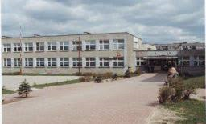
Curiosities about…
In 2017 the most innovative event was “Let's Promote Diversity – the European Day of Languages” from Poland. The event received 1702 votes and was organised by Primary School No. 1 in Żary.

Slide 7
One of the necessary things in learning a language is mastering its tongue twisters. Here are some examples from around the world:
Combien de sous sont ces saucissons-ci? Ces saucissons-ci sont six sous (French): “How much are these sausages here? These sausages here are six cents”.
Sister Sue sells sea shells. She sells sea shells on shore. The shells she sells. Are sea shells she sees? Sure she sees shells she sells.

Slide 8
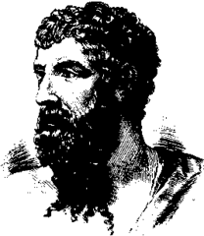
Ancient Greek playwright, Aristophanes, invented one of the longest words consisting of 183 letters which means a dish made of all kinds of fish, poultry and sauces.

Slide 9
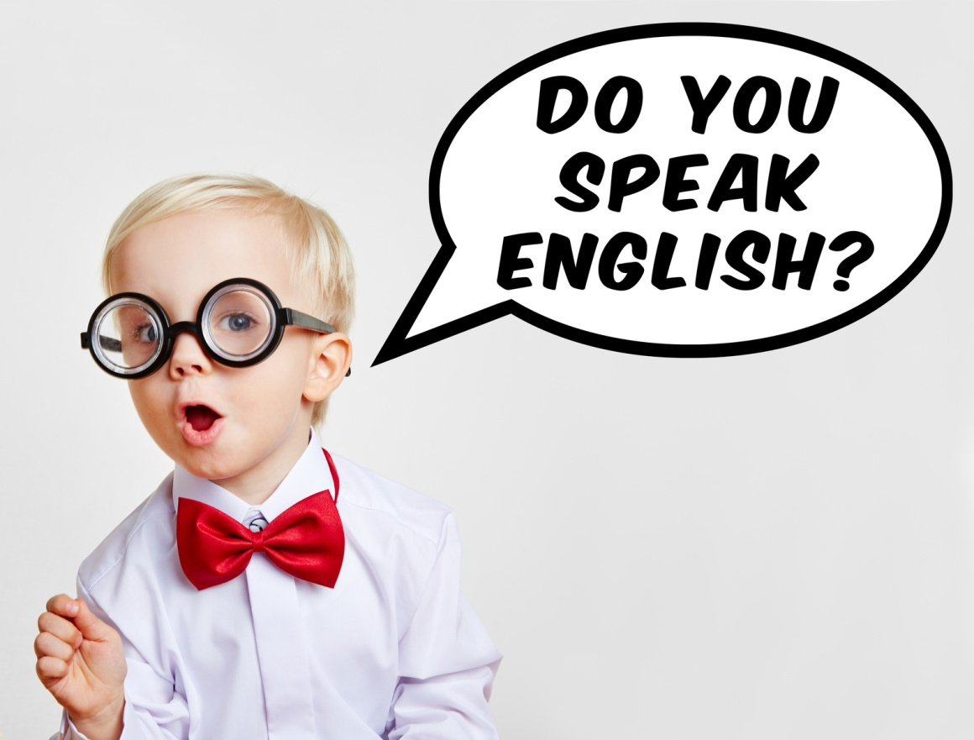
In English, the longest word is: pneumonoultramicroscopicsilicovolcanoconiosisThis is the longest English word whose definition appeared in the dictionary and refers to respiratory disease caused by inhalation of silica dust.

Slide 10
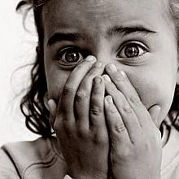
In many languages there are palindromes. Palindromes are interesting words and sentences that are read in the same way from the front and back. It is the fact that the Germans came up with a word, meaning fear of palindromes - Eibohphobie.

Slide 11
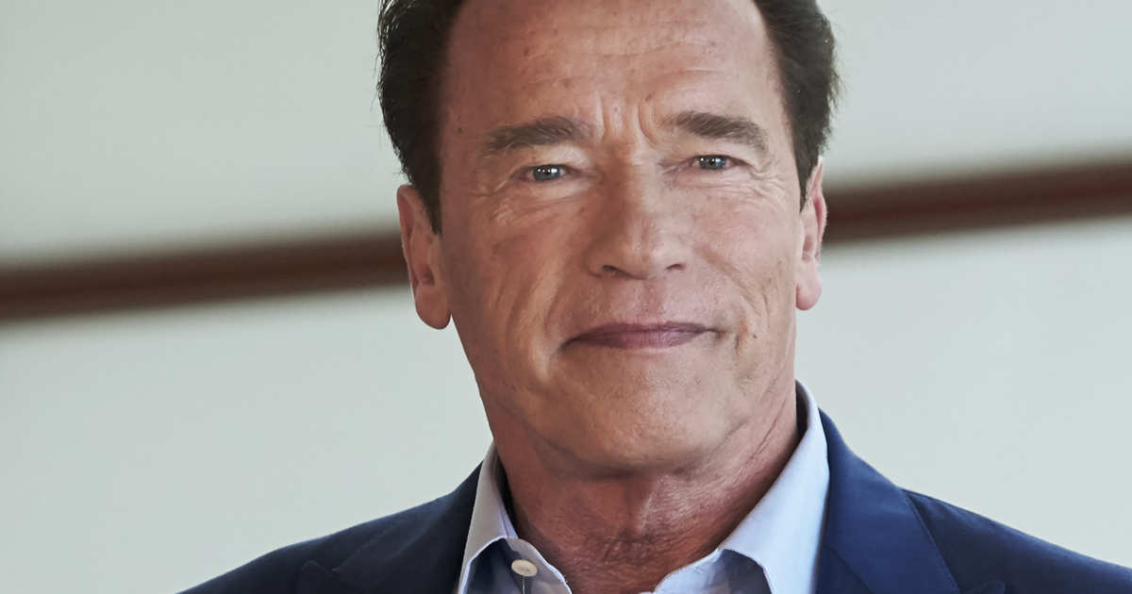
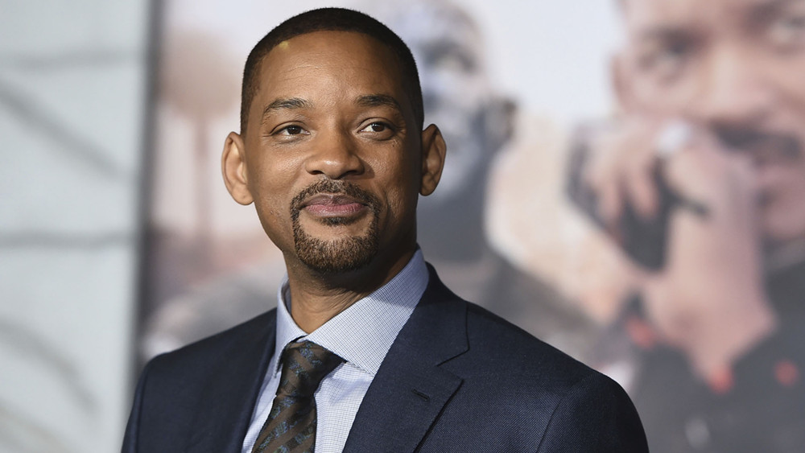
An additional impulse for learning foreign languages may be the information that many famous people speak many languages besides English, e.g. French (Mick Jagger), Spanish (Will Smith), Italian (Colin Firth), German (Arnold Schwarzenegger) or more than two (Shakira).

Slide 12
The End
Bibliography:
edl.ecml.at
youtube.com
hrpress.pl
praca-biznes.pl
thesource.com
shakira.com
vulture.com
pl.wikipedia.org
jows.pl
szkolnictwo.pl
blog.langlion.com
superbelfrzy.edu.pl
wielkikufer.pl
madamepolyglot.pl
Prepared by:
Martyna Suliga Ia

